Slide 1

Warby Parker: Marketing Funnel Analysis
By Andrew Malone
September 26th 2018

Slide 2
Table of Contents
Quiz Analysis (with recommended action points)
Sales Data Analysis (with recommended action points)

Slide 3
1. Quiz Analysis

Slide 4
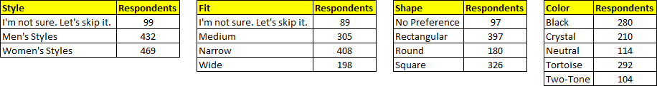
1.1 Quiz Response Analysis
Quiz responses are broken down as follows:
Most common style: Women’s (47%)
Most common fit: Narrow (41%)
Most common shape: Rectangular (40%)
Most common color: Tortoise (29%)

Slide 5
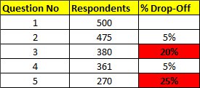
1.2 Drop-Off Rates
Survey data shows the following drop-off rates:
Questions 3 (“Which shapes do you like?”) and 5 (“When was your last eye exam?”) appear to cause a high percentage of users to discontinue the quiz
Re Question 3: Could this drop-off be due to the number of options available, or how the options are presented on-screen?
Re Question 5: Could this drop-off be due to users not knowing the date of their last eye exam, or perhaps deeming the question irrelevant? (NB: Responses to this question do not appear to feed into the “quiz” table. Are the responses being used for anything outside of the quiz? If not, it might be worth considering the removal of this question.)

Slide 6
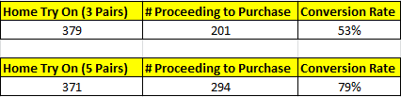
1.3 Conversion Rates (Quiz to Try On / Try On to Purchase)
Overall Conversion Rates are as follows:
When split as per the recently conducted A/B test, the results are:
The A/B test results suggest that the higher the number of pairs taken for home try on, the higher the number of sales. Might it be worth offering five pairs as standard, or perhaps even a higher number of options?

Slide 7
1.4 Conversion Rates (Split by “Style”)
When split by the response to survey question 1 (What are you looking for?), the purchase funnel shows the following data:
It would appear that a higher percentage of “Women’s Style” respondents progress from the survey to the home try on stage. However, a higher percentage of “Men’s Style” respondents go on to make a purchase from the home try on stage.
NB: It may be worth adding more data to the ‘home try on’ table (eg product ID) to enable analysis of instances where home try on DOES NOT lead to a purchase.

Slide 8
2. Sales Data Analysis

Slide 9
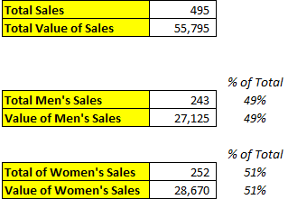
2.1 Sales Figures
Total sales for the period are as follows:
NB: A ‘Cost of Sales’ table would allow analysis of both cost and profit per item.

Slide 10
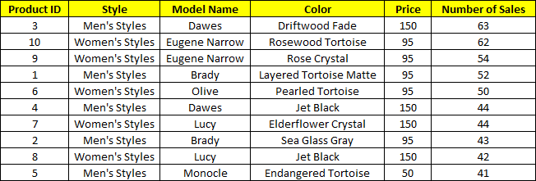
2.2 Best-selling products (by number of sales)
Total sales for the period are split by product as follows:
Best-selling Men’s product: Dawes – Driftwood Fade
Best-selling Women’s product: Eugene Narrow – Rosewood Tortoise

Slide 11
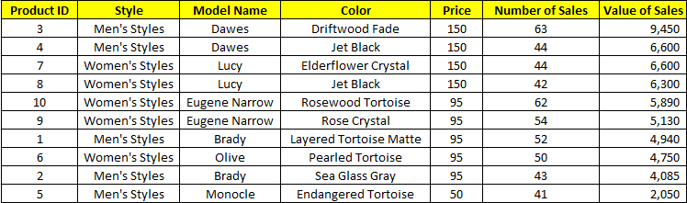
2.3 Best-selling products (by sales value)
The following table shows the product range in order of total sales value (highest to lowest):
Highest Value Men’s product: Dawes – Driftwood Fade
Highest Value Women’s product: Lucy – Elderflower Crystal

